Slide 1



Hakui Consulting
Github
Mevod's Strategy
Digital Marketing Analytics Fall 2021
Final Project
Middle Eastern Video on Demand
Presented By
Xinran Xie
2021.12.14

Slide 2


02
Agenda
Case Overview
Exploratory Data Analysis
Segmentation & Targeting
Allocation & Attribution
Customer Churn
Further Steps
Mevod's Strategy

Slide 3
03
About Mevod
Mevod, our client, is a Dubai based video on demand company that aims to become the dominant player of the regional OTT service market. Their current and potential competitors include Starz, an American OTT service company, and HBO. Unlike these foreign companies that treating the region as a secondary market, Movod would like to tailored to the Middle Eastern / Arabic-speaking market.
Current tactical plan:
Acquiring and/or producing native content (currently primarily generated in Egypt and Turkey)
Offering superior customer service to establish their committed presence to the region.
As of now, Mevod has a subscription business model, billed in a 4 month cycle, with six different pricing schemes:
No trial fee / Discounted trial fee
7-day trial fee / 14-day trial fee
Low priced monthly plan / High priced monthly plan
Mevod's Strategy

Slide 4

04
Data Overview
Mevod's Strategy
Channel_spend
Subscribers
CQM_engagenent
Customer_service_reps
Total spend per select channels per month, 2019/07- 2020/04
Past or current subscribers' records include data such as characteristics and demographics
Product usage data measures the product engagement of a given subscriber in a given date
Customer service representative data set include records of customer service representative who serves multiple subscribers.

Slide 5
05
Understanding Subscriber Demographics
88%
63%
71%
49%
Mevod's Strategy
Female Subscribers
IOS Users
Young and Middle Aged Adults
Base Internet Plan
In total, there are 227,628 past / current subscribers. All users are from United Arab Emirates and speak Arabic.

Slide 6
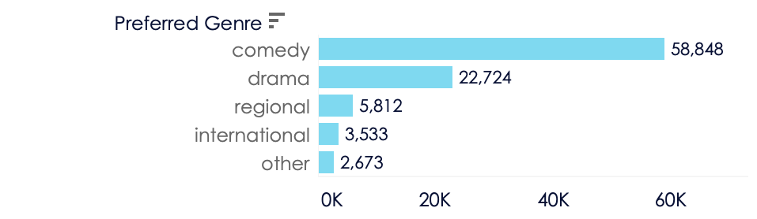

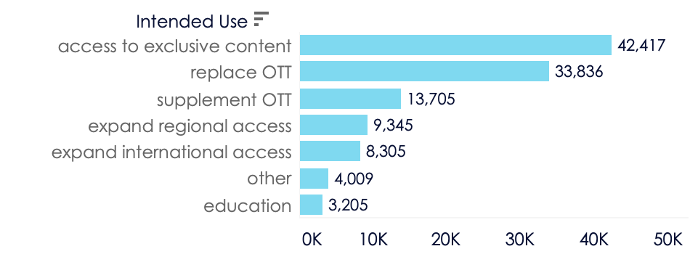
06
Understanding Our Customers
There are 17 SDGs and 169 targets in total. While they are all important and interrelated, some will be more relevant to your business than others.
28 hours
Average weekly consumption hour of all customers
Mevod's Strategy
3 currently utilized services
Average weekly number of service currently utilized for all customers
2 ideal streaming services
Average ideal number of streaming services wanted for all customers

Slide 7

06
Subscribers' Payments
Rakbank
17.9%
92%
Paypal
31.6%
Users made successful payments
Najam
3.7%
Mevod's Strategy
65%
CBD
7.4%
Users finished trial without calcellation
3.9%
Users requested refund after trial
Standard Charter
39.3%
14.15 days
1.56 UAE dirham
Payment Type
Average account life, creation to cancellation
Average net revenue from each subscriber

Slide 8
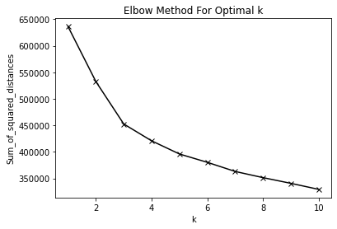
07
Data Preprocessing
Segmentation K-means Modeling
Unreasonable data points and null values are removed
Categorical variables are dummied for modeling
Standard scaler to numerical features for modeling
Features Used
Age: 16-100
Weekly Consumption Hour: 1-77 hours/week
Gender: Female, Male
Operation System: Android, iOS
Internet Package Type: Base, Economy, Enhanced
Preferred Genre: Comedy, Drama, Regional, International, Other
Intend Use: Access to exclusive content, Replace OTT, Supplement OTT, Expand regional access, Expand international access, Education, Other
Mevod's Strategy
K=3
Elbow Method
k=3 indicates the turning point from a steep to a flat slope
Therefore there will be 3 clusters of customers

Slide 9
08
Segmentation
Mainly target to the Addicted Generation X because Mevod has more customers in this group, and these people also spend more time on Mevod on a weekly basis compare to other segments.
Comedy Millennials
Addicted Gen X
Drama Lady Boomers
Demographics
Age of 25-40
Mostly female
Age of 41-55
A mix of male and female
Age of 56-74
Mostly female
Mevod's Strategy
Only watch comedy
Intend usage is to replace OTT, but also to our exclusive content
Watch comedy and some drama
Intend to access to exclusive content
Watch comedy and drama
Intend to access to exclusive content
Psychographics
Behavioral
Weekly spend 27 hours on our service on average.
Weekly spend 36 hours on our service on average.
Weekly spend 26 hours on our service on average.

Slide 10
09
/ Advanced quality videos
Provide 4K resolution videos to the enhanced internet plan subscribers, as better quality products would keep customers.
/ Content genre
Focus on drama and comedy.
/ Exclusive contents
As the most unique and special feature to an OTT platform. Mevod should focus on producing more exclusive contents.
/ Keep Mevod positioning as dominant OTT service
Keep subscribers' main streaming service as Mevod instead of a supplement.
Marketing Mix
Addicted Generation X
Mevod's Strategy

Slide 11
10
Allocation & Attribution
Data Preprocessing
Top 3 lowest CAC channels
Channel spending dataset: interpret date as the spending for next month, so only use data in 2019/7 to 2020/3
Channels examples: affiliate, appstore, bing, email, facebook, google, pinterest, playstore, quora, search, tv, twitter, youtube.
Rank
Channel
Average CAC
1
Facebook
7.82
Mevod's Strategy
2
Search
9.55
3
Pinterest
10.20
For the purpose of getting more customer, Mevod should focus on channels that not only have a large audience reach, but also have the lowest average cost of acquiring customers, therefore more customer could be gained with the same amount of budget.
CAC varies by month, therefore channels can be chosen by seasonality, but more observations needed.

Slide 12
11
Customer Churn
Features
Data Preprocessing
Payment period: 0-3
Number of weekly services utilized: 0-10
Weekly consumption hour: 0-76
Join Fee: 0-0.73
Monthly_Price: 4.73-5.10
Gender: Male / Female
Retarget customer: True / False
Operation System: iOS / Android
Genre: Comedy / Drama / International / Regional / Other
Intend Use: Access to exclusive content, Replace OTT, Supplement OTT, Expand regional access, Expand international access, Education, Other
Internet Package Type: Base, Economy, Enhanced
Engagement features: app opens time, number of videos completed, number of videos rated, number of videos watched more thann 30 seconds, number of series started
Unreasonable data points are removed
Categorical variables are dummied for modeling
Mevod's Strategy
Models
Linear Regression
Logistic Regression

Slide 13
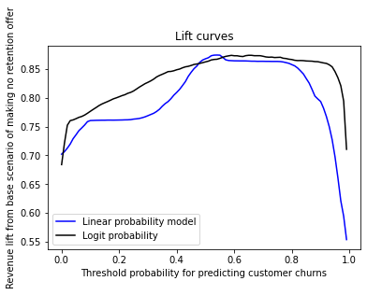
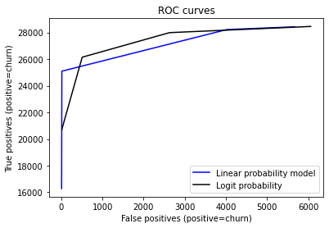
12
Model Performance & Threshold
Mevod's Strategy
Both models have a R-squared aroundn 0.6
Threshold = 0.53
Meaning 60% of the data could be explained by model
At this threshold, Mevod would generate most revenue

Slide 14
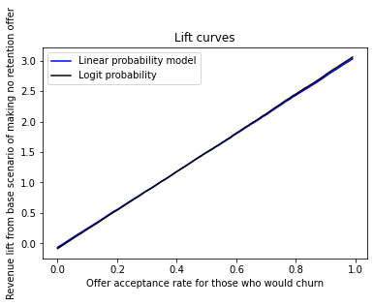
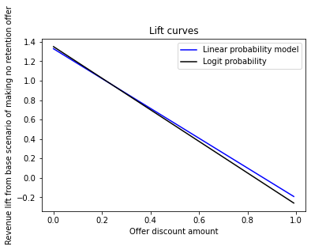
13
Revenue Lift
Model Assumptions
Mevod's Strategy
All parameters fixed:
acceptance_rate_nonchurn = 1
acceptance_rate_churn = 0.5
threshold = 0.53
base_price = 4.73 (base pricing scheme in UAE dirham)
discount_amount = 0.3
Offers will be distributed to everyone as the model is not perfectly identifying high likelihood churners, and

Slide 15

14
Improvements
1. Data Source & Quality
The data provided is not in a good quality. Many unreasonable records and limited survey questions. If clearer the targeted population is understood, then more precisely marketing strategies could be formulated.
2. More Information Needed
In order to make appropriate business strategies, it is important to understand our client well. If possible, more background information on current business model is welcomed.
Mevod's Strategy
3. Models Could be Further Modified
Current Churn model could not predict all possible churners. Advanced machine learning model could be used to identify key features of churner and them make corresponding discount offers and other marketing strategies.

Slide 16
15
/ Targeting Addicted Gen X as Mevod's main focus customer, and providing high quality contents to advanced internet subscribers.
/ Focus on exclusive contents, mainly comedy and drama.
/ Facebook, search, and Pinterest are the three lowest CAC channels.
/ Mevod should make discount offer to everyone due to short account life and low net revenue
Take aways
Mevod's Strategy

Slide 17


16
Thank You
Xinran Xie
1555 Century Ave, Pudong, Shanghai
https://github.com/cocohakui/21Fall-Marketing-Analytics
@cocohakui

